Slide 1
Toronto Airbnb data research
ML-1000-3 Assigment3
Ketao Li, Kush Halani, Josue Romain, Juan Peña
York University. School of Continuing Studies. March 19th, 2020

Slide 2
Background
Toronto has been one of the hottest markets for Airbnb in Canada, with over 26,000 listings as of Feb 2020. This means there are over 40 homes being rented out per square km in Toronto on Airbnb!
How to find a solution to the business factor by using machine learning to look for patterns in the large batches of data?

Slide 3
Business Goals
To stablish how do the location, room type, number of reviews, availability, number of reviews, minimum nights and host listing count can affect rental rates
To establish some groups that can be suggested by the Airbnb platform for different kinds of preferences.

Slide 4
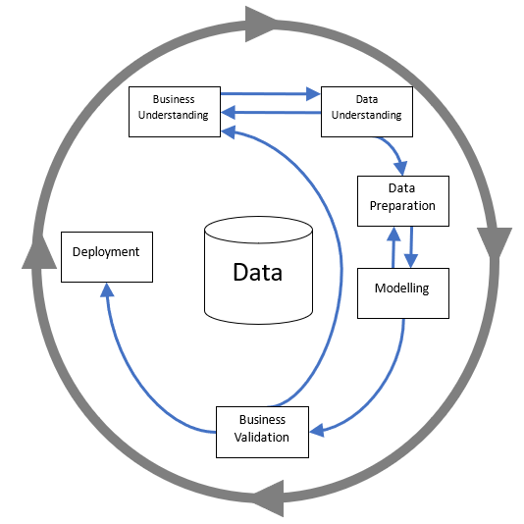
Business Goals

Slide 5
Data Exploration
id | listing ID
name | Listing Title
host_id | ID of Host
host_name | Name of Host
neighbourhood_group | Borough that contains listing
neighbourhood | Name of neighbourhood that listing is in
latitude | latitude coordinates of listing
longitude | longitude coordinates of listing
Data dictionary

Slide 6
Data Exploration
room_type | Type of public space that is being offered
price | price per night in dollars
minimum_nights | minimum number of nights required to book listing
number_of_reviews | total number of reviews that listing has accumulated
last_review | date in which listing was last reviewed
reviews_per_month | total number of reviews per month
calculated_host_listings_count | amount of listing per host
availability_365 | number of days per year the listing is active
Data dictionary

Slide 7
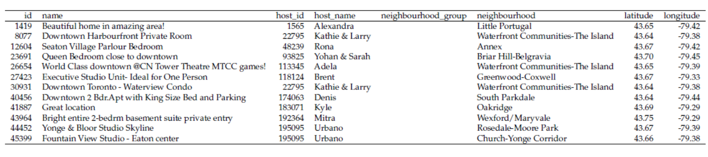
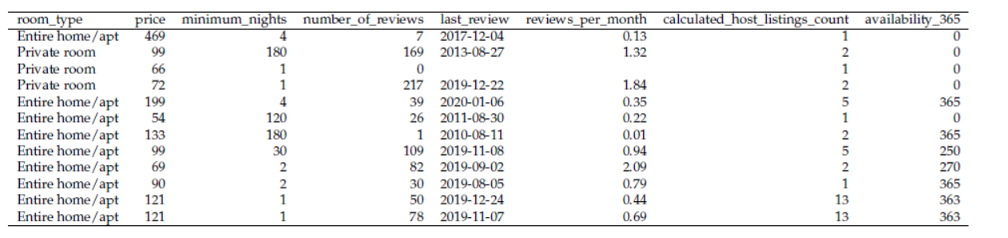
Data Exploration

Slide 8
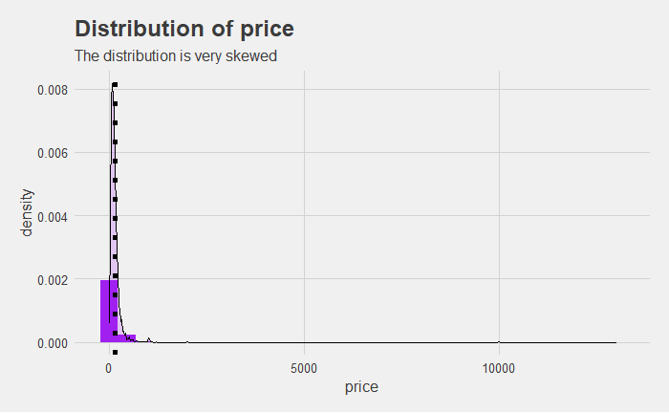
Data Exploration

Slide 9
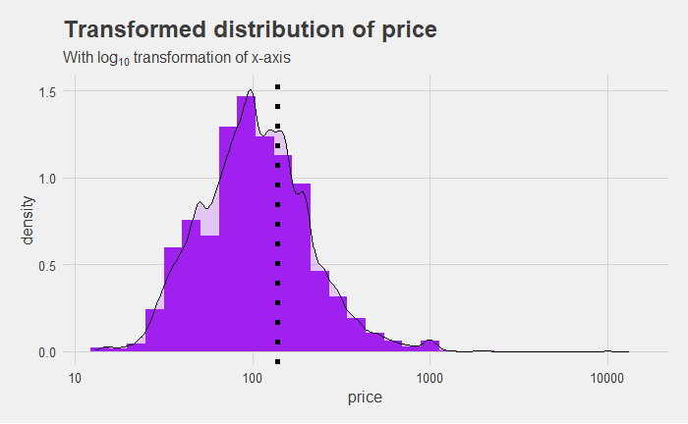
Data Exploration

Slide 10
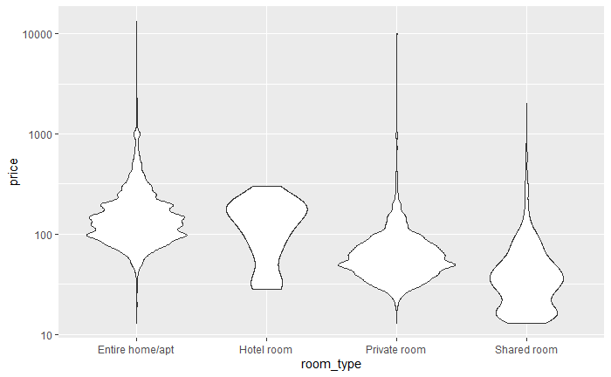
Data Exploration

Slide 11
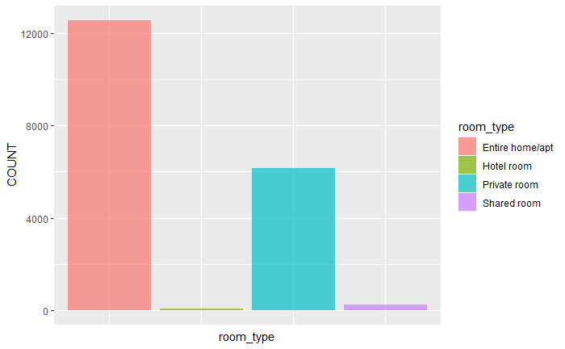
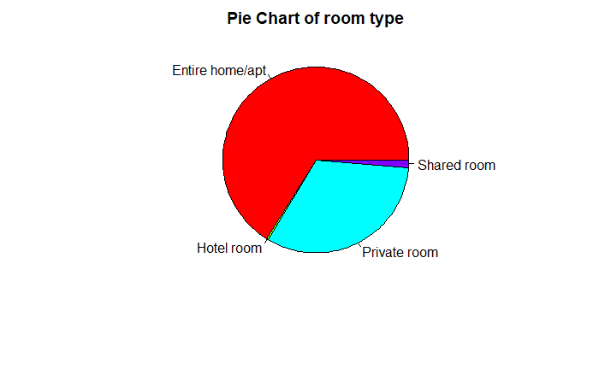
Data Exploration

Slide 12
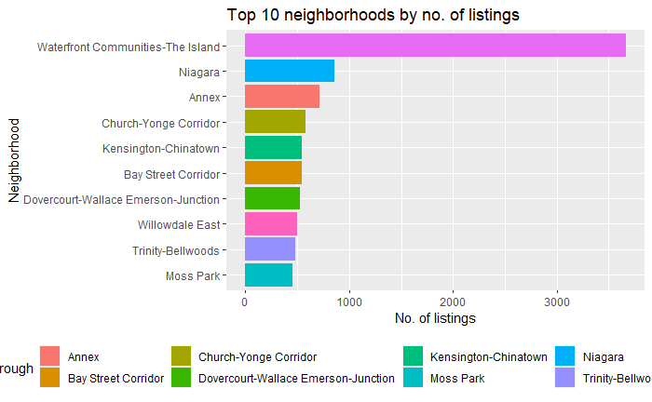
Data Exploration

Slide 13
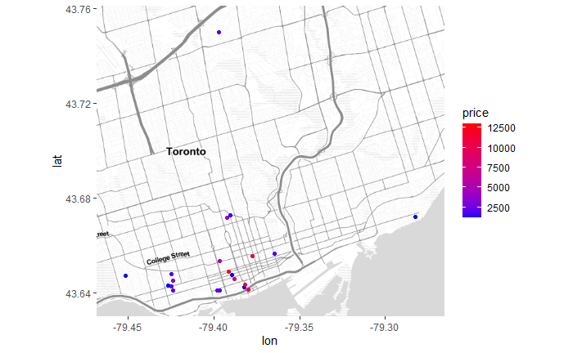
Data Exploration

Slide 14
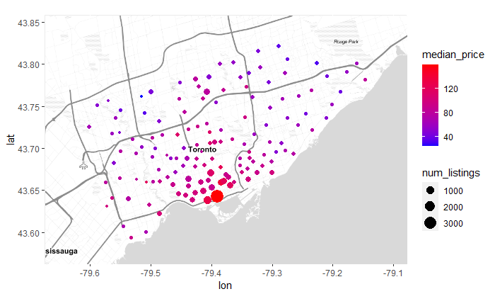
Data Exploration

Slide 15
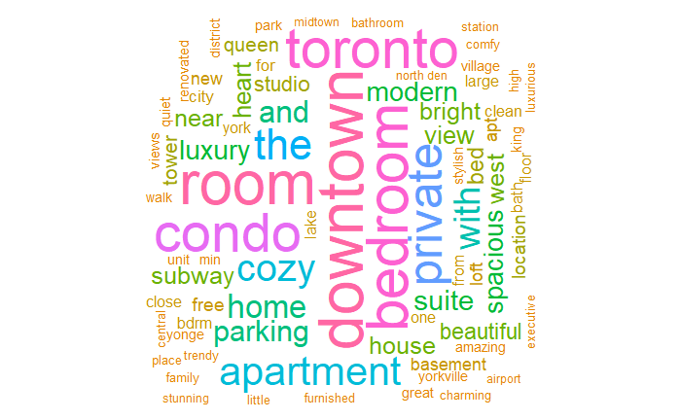
Data Exploration

Slide 16
Using the supervised learning methods
Firstly, our team use two kinds of linear regression methods.
Secondly, our team evaluates their performances and choose the best one.

Slide 17
first_model <- train(price ~ latitude + longitude + room_type + minimum_nights + availability_365 , data = airbnb_train, method = "lm")
Using the supervised learning methods
Residuals:
Coefficients:
Min | 1Q | Median | 3Q | Max
-196.5 | -59.2 | -22.3 | 16.3 | 9879.3
 | Estimate | Std. Error | t value | Pr(>|t|)
(Intercept) | 3.028e+04 | 3.232e+03 | 9.369 | < 2e-16
latitude | -4.218e+02 | 3.960e+01 | -10.652 | < 2e-16
longitude | 1.468e+02 | 2.862e+01 | 5.129 | 2.95e-07
room_type | -4.584e+01 | 1.855e+00 | -24.711 | < 2e-16
minimum_nights | -9.998e-02 | 6.689e-02 | -1.495 | 0.135
availability_365 | 1.290e-01 | 1.358e-02 | 9.504 | < 2e-16
Residual standard error: 195.4 on 13307 degrees of freedom
Multiple R-squared: 0.07377, Adjusted R-squared: 0.07342
F-statistic: 212 on 5 and 13307 DF, p-value: < 2.2e-16

Slide 18
second_model <- lm(log(price) ~ room_type + latitude + longitude + number_of_reviews +availability_365 + reviews_per_month + calculated_host_listings_count + minimum_nights, data = learn)
Using the supervised learning methods
Residuals:
Coefficients:
Min | 1Q | Median | 3Q | Max
-1.10574 | -0.25653 | -0.01645 | 0.24385 | 1.40928
 | Estimate | Std. Error | t value | Pr(>|t|)
(Intercept) | 1.395e+02 | 6.798e+00 | 20.516 | < 2e-16
latitude | -2.025e+00 | 8.371e-02 | -24.190 | < 2e-16
longitude | 5.796e-01 | 6.064e-02 | 9.557 | < 2e-16
room_type | -2.599e-01 | 3.848e-03 | -67.554 | < 2e-16
minimum_nights | -2.221e-04 | 1.272e-04 | -1.746 | 0.0809
availability_365 | 2.080e-04 | 2.860e-05 | 7.273 | 3.77e-13
Residual standard error: 0.3523 on 10593 degrees of freedom
Multiple R-squared: 0.3731, Adjusted R-squared: 0.3726
F-statistic: 212 on 5 and 13307 DF, p-value: < 2.2e-16

Slide 19
Using the unsupervised learning methods
Model Deployment
After the performance evaluation, we choose the second model to develop one shiny app to predict Toronto Airbnb rental rate:
https://li-ketao.shinyapps.io/ML1000-3/

Slide 20
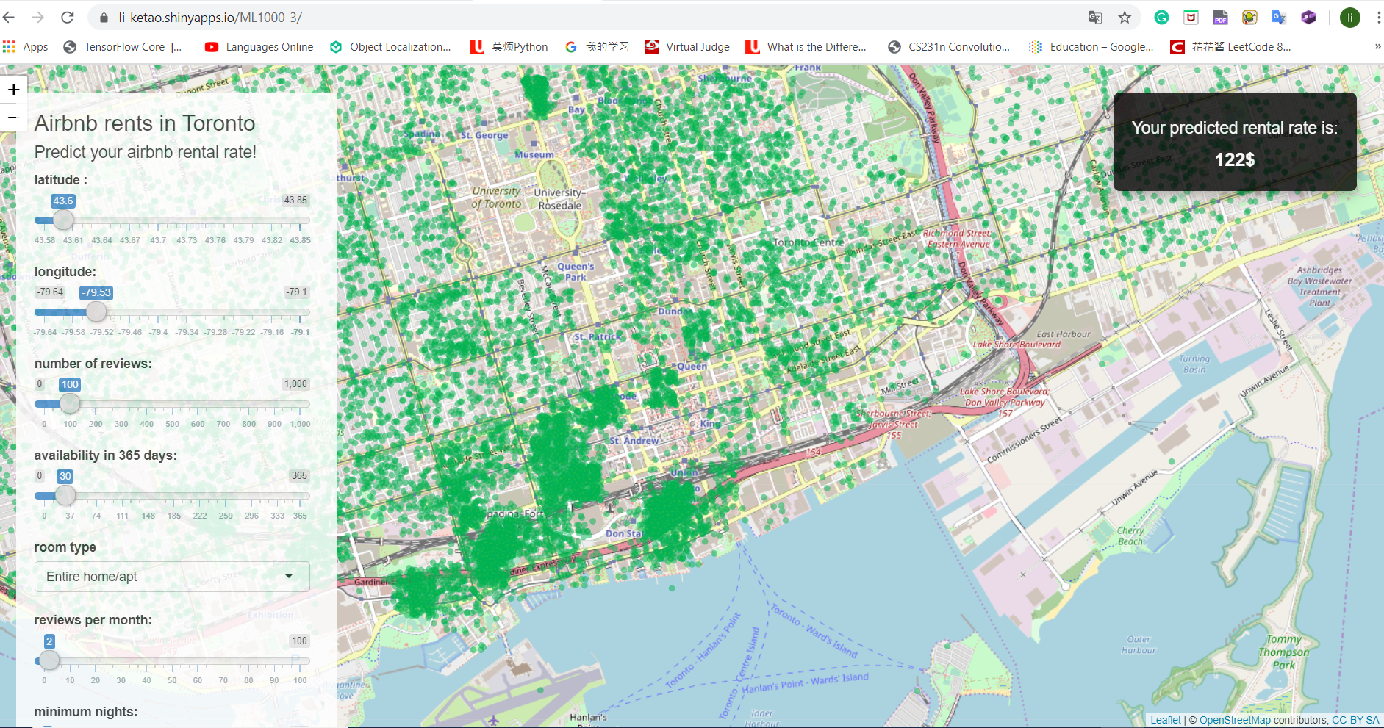
Using the unsupervised learning methods

Slide 21
Using the unsupervised learning methods
Firstly, our team use Partitioning Clustering Approach and Hierarchical clustering approache to cluster the listings.
Secondly, our team evaluates their performances and choose the best one.

Slide 22
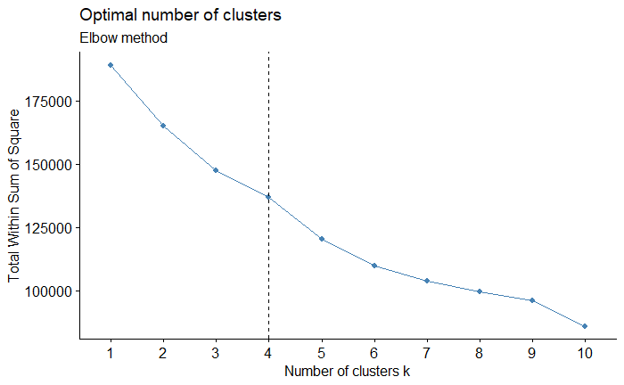
Using the unsupervised learning methods

Slide 23
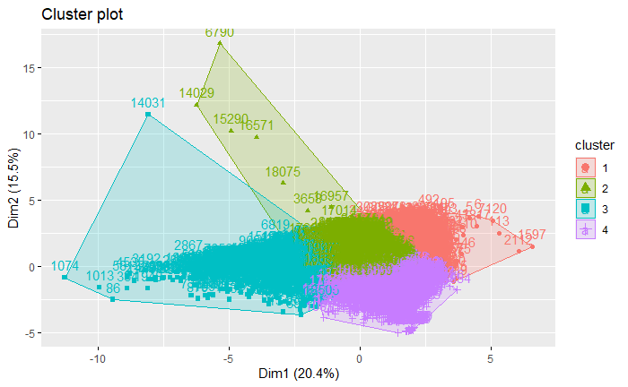
Using the unsupervised learning methods

Slide 24
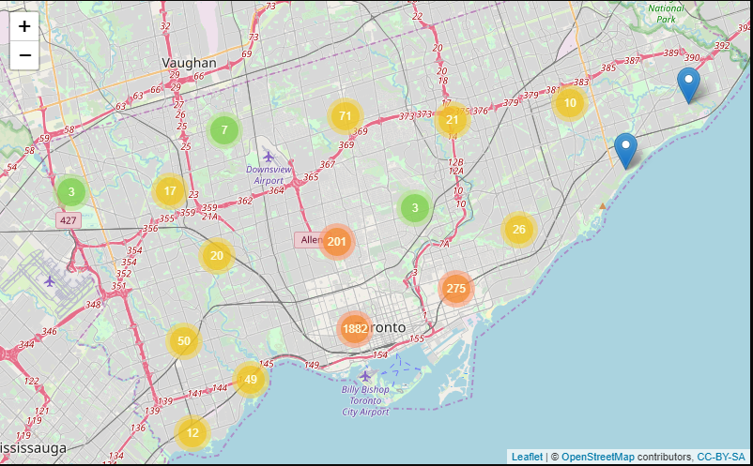
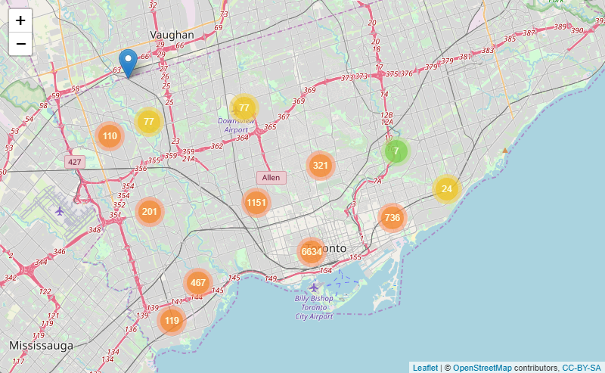
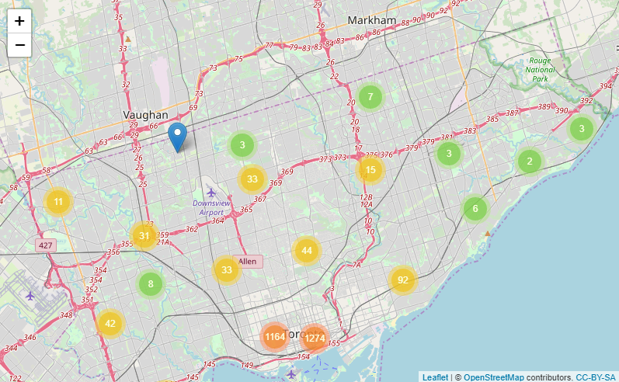
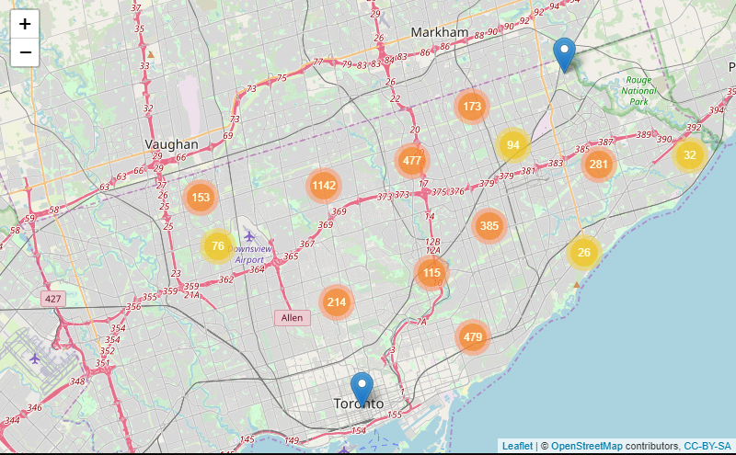
Using the unsupervised learning methods
Group1:2649
Group2:9925
Group3:2800
Group4:3649

Slide 25
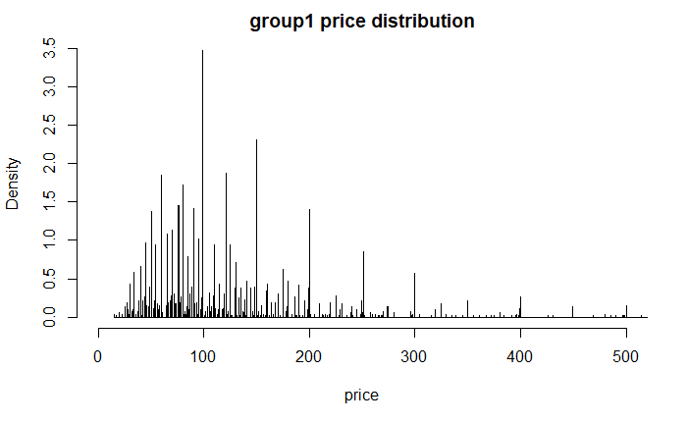
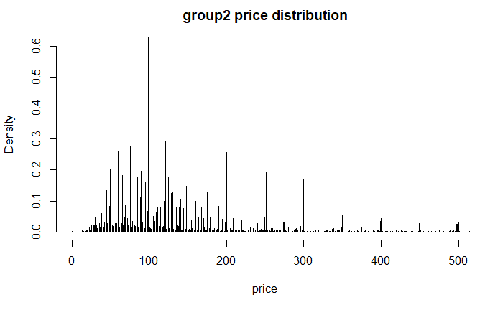
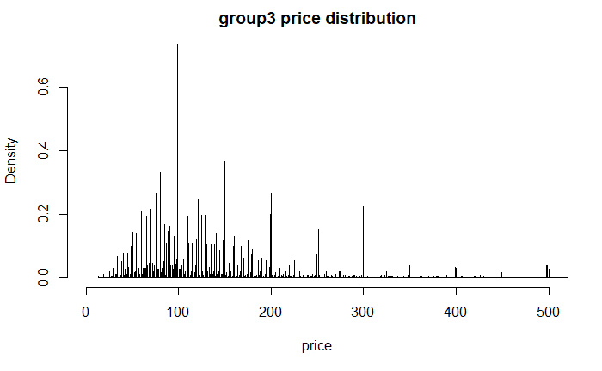
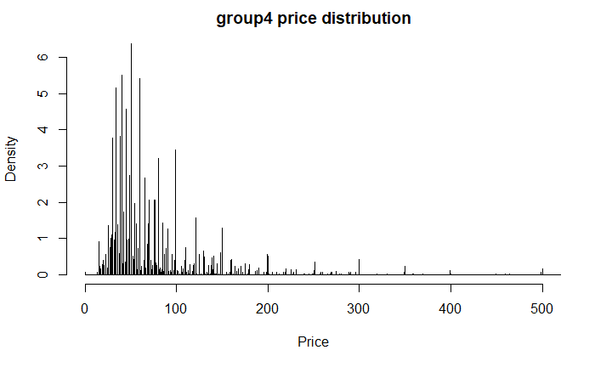
Using the unsupervised learning methods

Slide 26
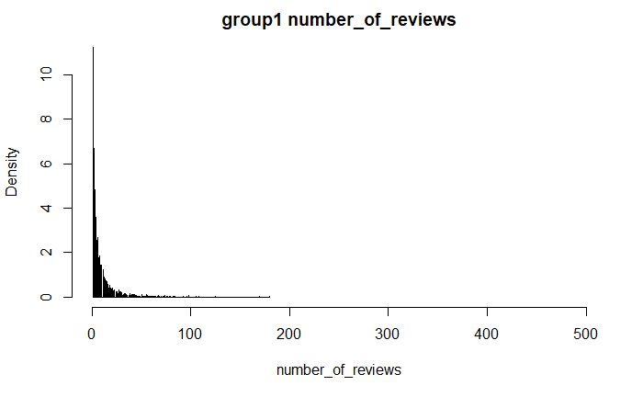
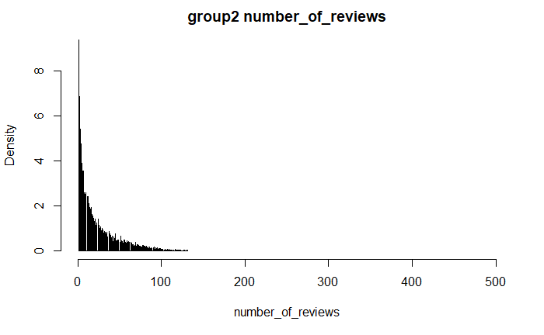
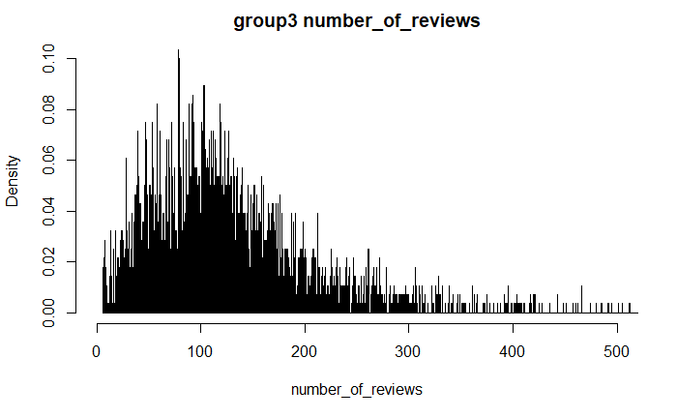
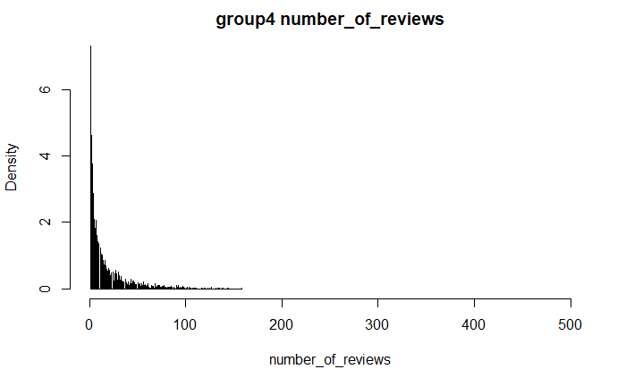
Using the unsupervised learning methods

Slide 27
Using the unsupervised learning methods
Project deliverable
 | Group features | Business value
Group1 | Median rental rate | Recommended to the moderate customers
Group2 | High rental rate, low attention and convenient transportation. | Recommended to the customers that prefer the convenient transportation and don't mind the attention.
Group3 | High rental rate, high attention and convenient transportation. | Recommended to the customers that prefer the convenient transportation and mind the attention.
Group4 | the rental rate is low. | Recommended to the customers that have a high sensitivity to price

